Slide 1
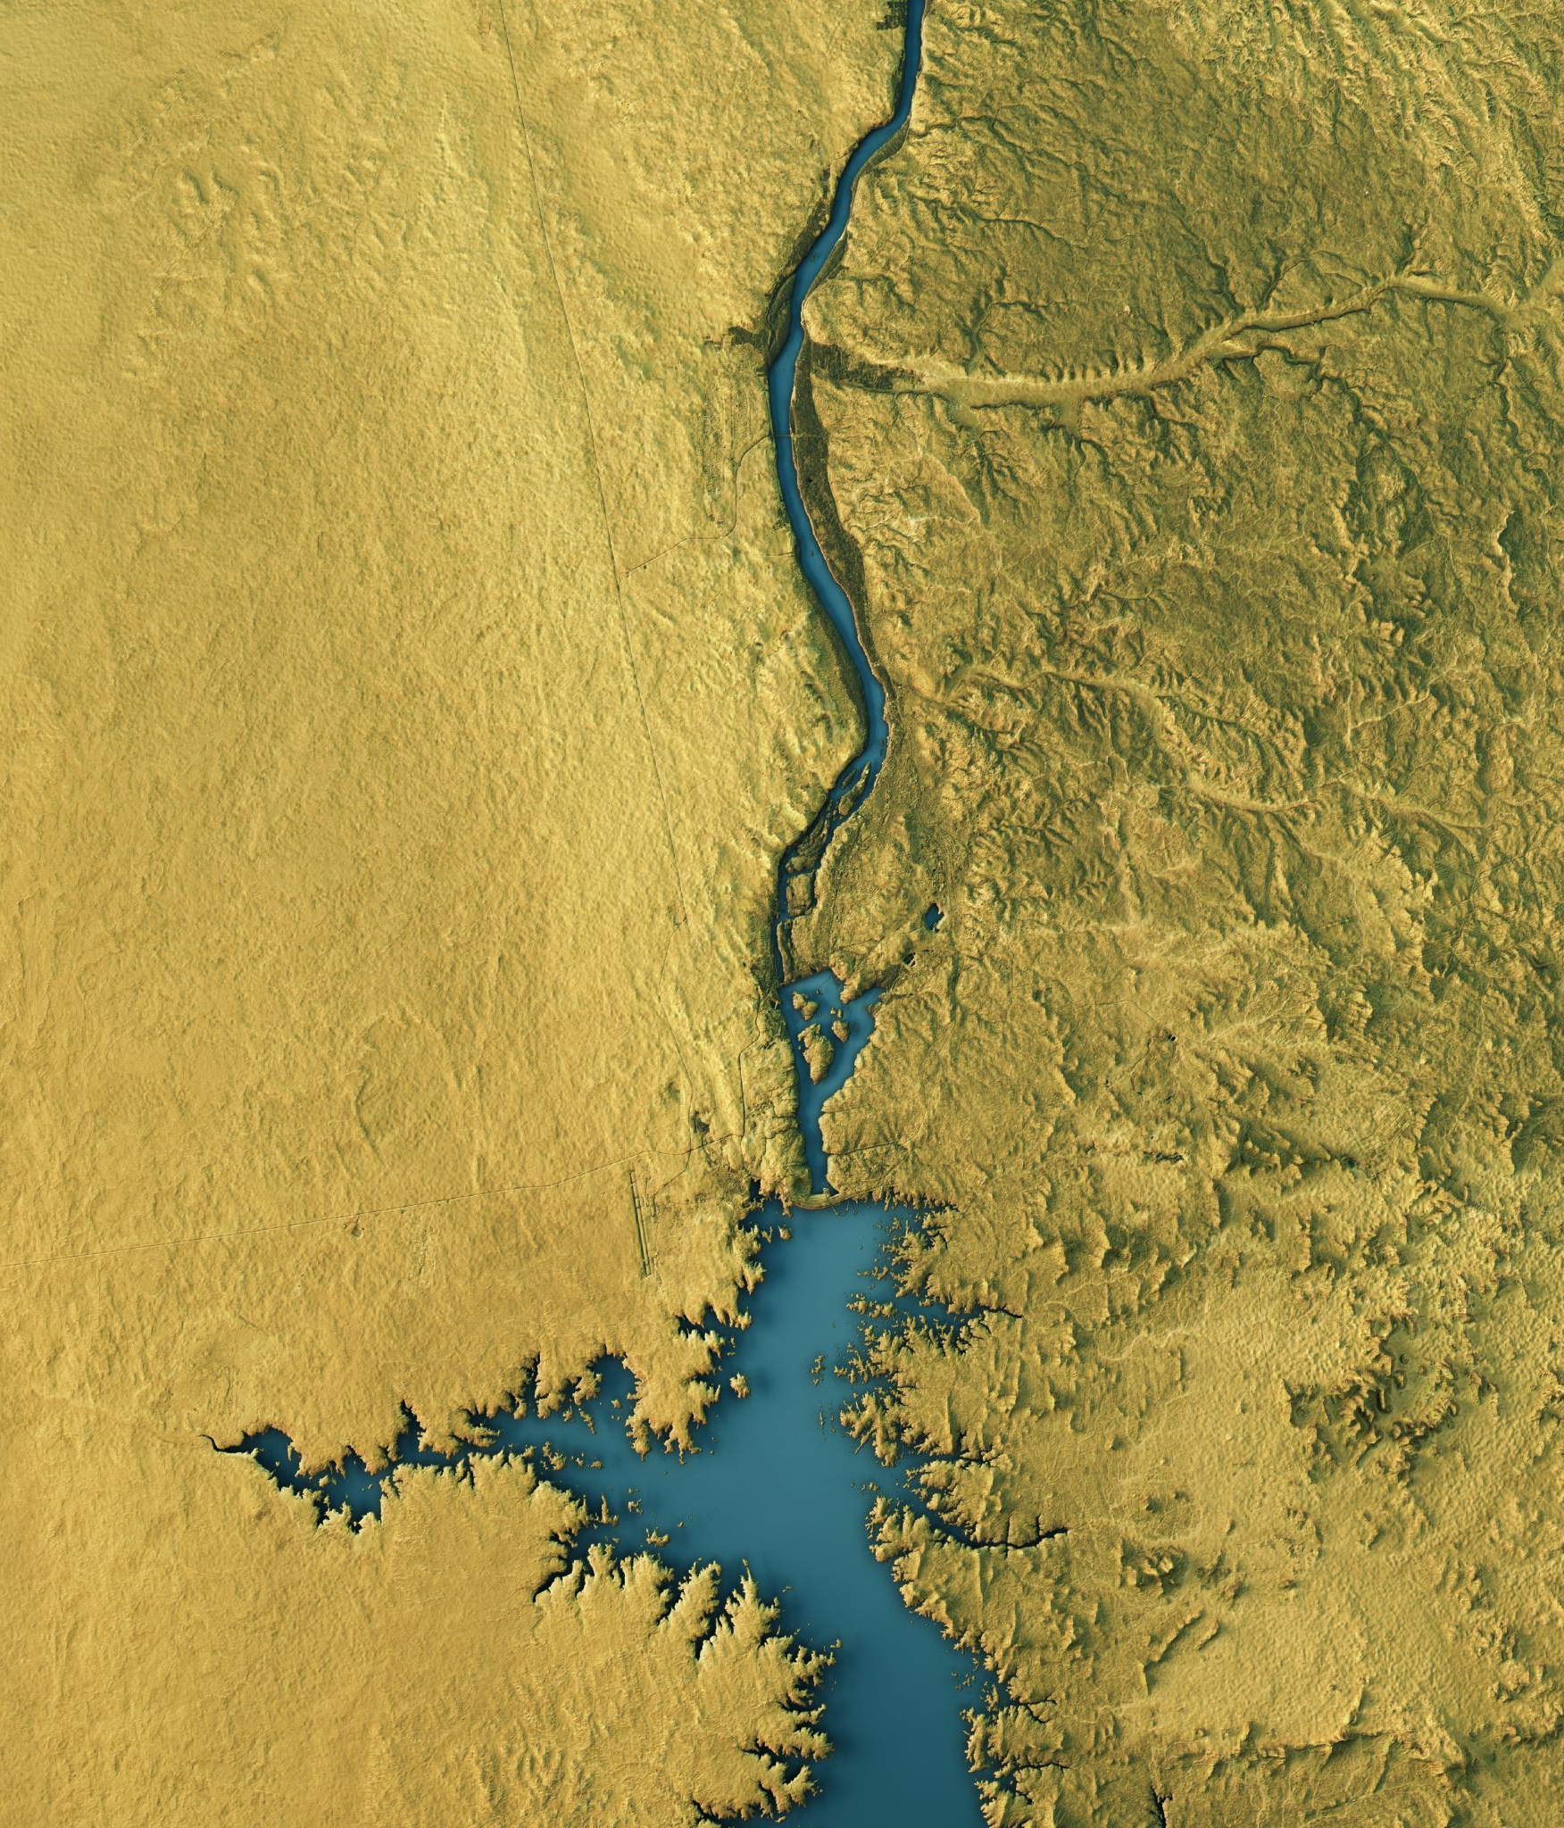
Water Body Extraction from Remote Sensing Images USING U-NET
Study Area: Telangana

Slide 2

Introduction
Water body extraction from satellite images is crucial for various real-world applications.
In Urban Planning, it helps manage reservoirs, lakes, and drainage systems.
In Agriculture, it supports irrigation planning and water resource monitoring.
For Disaster Management, accurate mapping of water bodies aids in flood prediction, emergency response, and environmental monitoring.

Slide 3
Water Body Extraction Methods
Traditional Methods
Water bodies were extracted through manual digitization or visual interpretation of satellite images.
This process is accurate at small scales but time-consuming and not scalable for large or frequently changing regions.
Spectral-Index based Methods
Spectral indices use reflectance properties of water in different bands.
Popular Indices are NDWI (Normalized Difference Water Index), MNDWI (Modified NDWI),
AWEI (Automated Water Extraction Index).
These indices are simple to use but threshold selection is often empirical and may not generalize well.

Slide 4
Water Body Extraction Methods
3. Machine Learning Approaches
Classical machine learning algorithms (e.g., Random Forests, SVMs, Decision Trees) are used for water classification.
Require manual feature engineering, which may not capture complex patterns.
Performance is sensitive to training data quality and feature selection.
4. Deep Learning Methods
Deep neural networks learn features automatically from raw pixel data—no manual feature engineering required.
Delivers end-to-end segmentation, outputting a pixel-wise classification map.

Slide 5
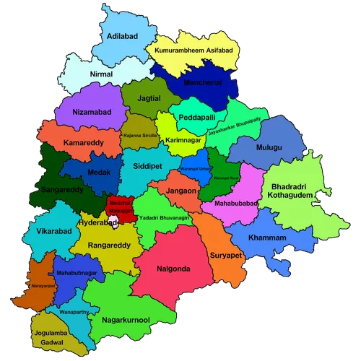
Study Area - Telangana

Slide 6

Data Acquisition
Satellite Source: Sentinel-2
Sentinel-2 provides multi-spectral data at varying resolutions (10m, 20m, 60m), with frequent revisit times, making it ideal for temporal and spatial monitoring.
Bands Selected: NIR and SWIR
Spatial Resolution:
B8 (NIR) –10m
B8A (NIR) – 20m
B11 (SWIR) – 20m
B12 (SWIR) – 20m
AOI: Telangana, India
These bands are selected because they support the calculation of Spectral Indices.

Slide 7
Data Preprocessing
TIF files are present in a specific folder
(folder_id = '1vmo3Mje4Oc2klXMQHvVUx_HIIHqzSOuF')
Only the files that containing bands 8, 8A, 11, 12 are selected because of their importance in Water detection.
Then, each file is split into 512 X 512 patches using a sliding window approach which handles non-uniform image sizes by adjusting window bounds.
Patches that contain Nan value in any band of atleast one pixel are discarded.
A total of 4260 patches are generated.

Slide 8
Data Preprocessing
For each patch, a false color composite is generated by assigning Band 8 to Red Channel, Band 11 to Green Channel and Band 12 to Blue Channel.
Normalized pixel values to the 0-255 range for saving as .png
NDWI is computed from each patch:
A combination of spectral and intensity filtering is applied:
Identify pixels with:
Very dark NIR reflectance (bottom 5%)
Very dark SWIR reflectance (bottom 5%)
High NDWI values (greater than 0.6)
Combine with intensity thresholding (bottom 3%) for extra robustness

Slide 9
Data Preprocessing
To clean up noisy predictions:
Remove small objects (area < 100 pixels)
Binary closing and opening using disk-shaped structuring elements
Final result is a approximate clean binary water mask
Masks generated are saved as .png with 0 indicating no-water and 1 indicating water for each pixel.

Slide 10
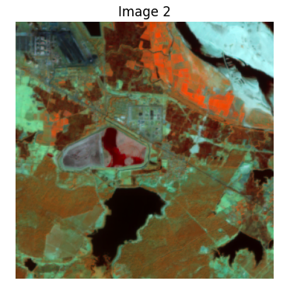
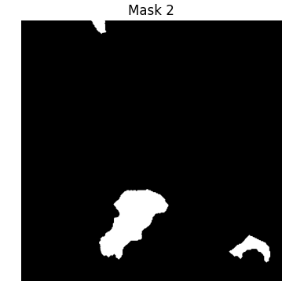
Some Sample Patches

Slide 11
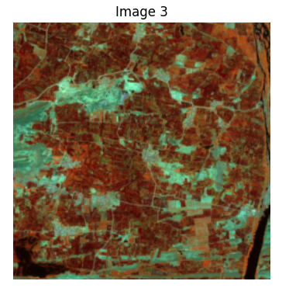
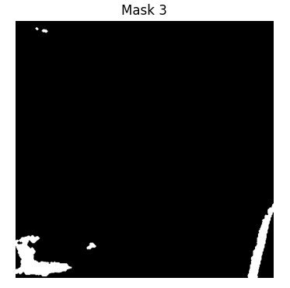
Some Sample Patches

Slide 12
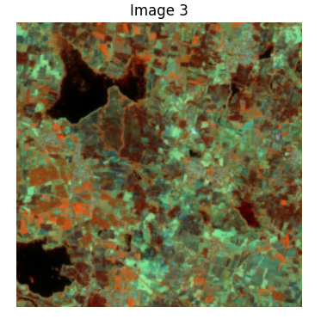
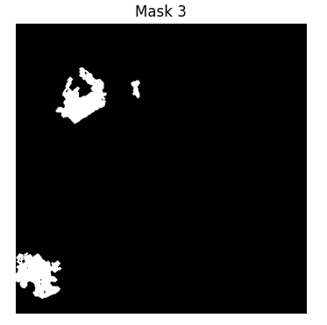
Some Sample Patches

Slide 13
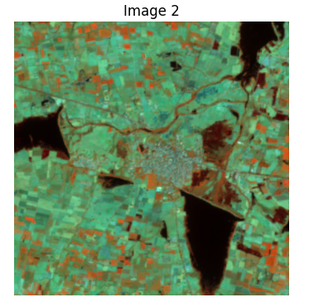
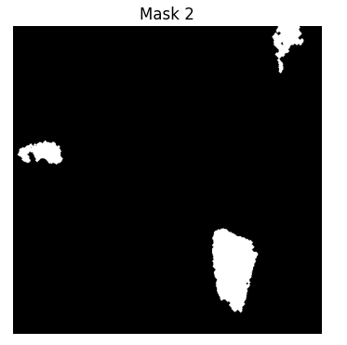
Some Sample Patches

Slide 14
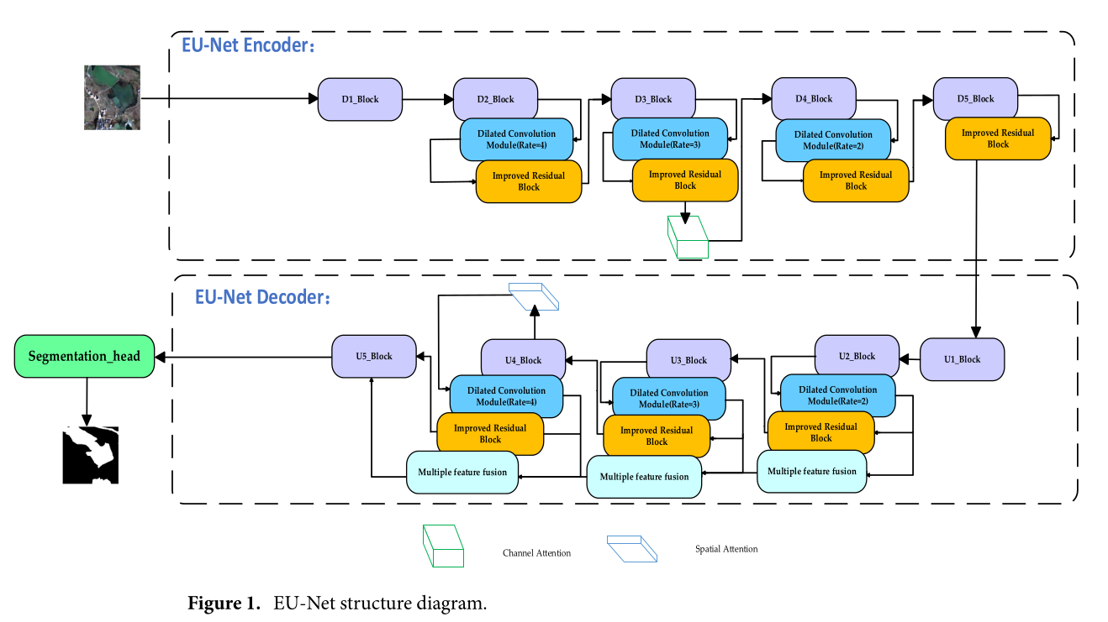

Slide 15
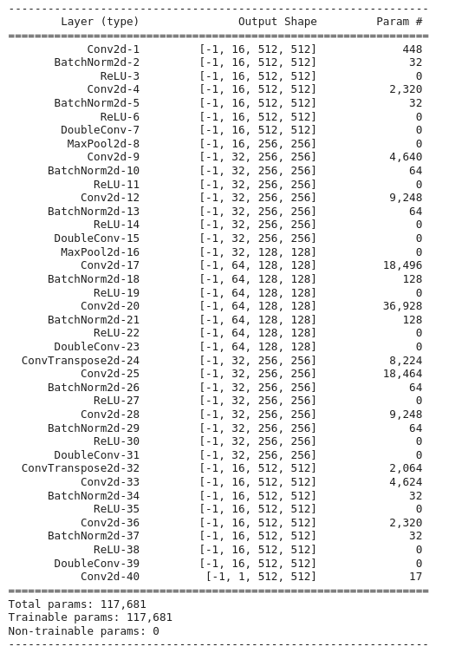
Model Architecture

Slide 16
Experimental Setup
Frameworks Used
PyTorch 2.1.0.
Image and Mask Transformations
Resized the image to 512x512 pixels.
Normalized images using standard ImageNet Mean and Standard Deviation which helps in faster and more stable training.
Resized label iamge to 512x512.
Each mask pixel becomes a float value in [0, 1].

Slide 17
Experimental Setup
Training Process
Loss Funtion: BCE (Binary Cross Entropy)
Optimizer: Adam because it is efficient and widely used in segmentation tasks.
Used a Learning rate scheduler and learning rate is changed if validation loss does not change and is used to improve the training process.
For each epoch, loss, pixel-wise accuracy, dice coefficient, IoU are calculated for both the training and validation data.

Slide 18
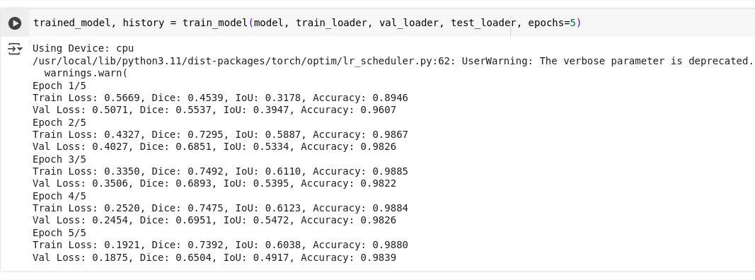
Experimental Setup
Training Process
Loss Funtion: BCE (Binary Cross Entropy)
Optimizer: Adam because it is efficient and widely used in segmentation tasks.
Used a Learning rate scheduler and learning rate is changed if validation loss does not change and is used to improve the training process.
For each epoch, loss, pixel-wise accuracy, dice coefficient, IoU are calculated for both the training and validation data.

Slide 19
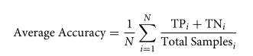
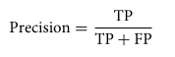
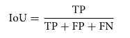
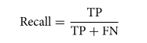
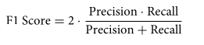
Metrics Calculated for Test Data:

Slide 20
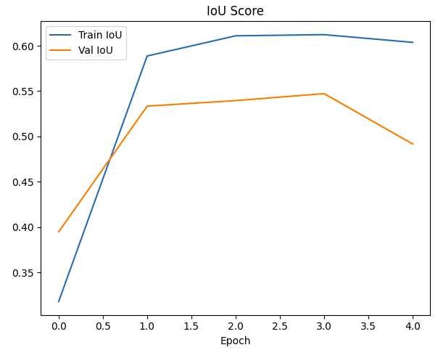
Curves

Slide 21
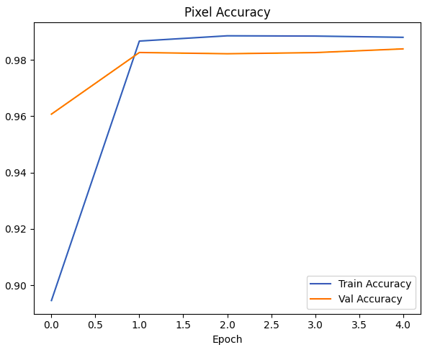
Curves

Slide 22
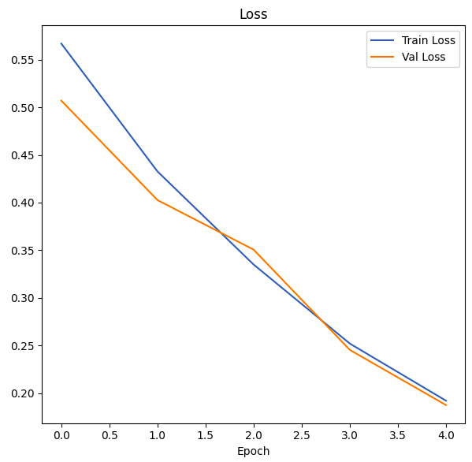
Curves

Slide 23
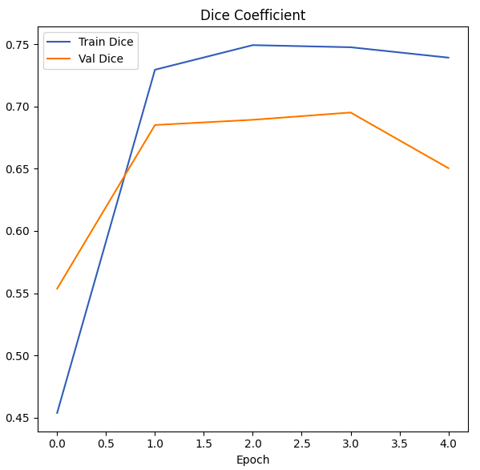
Curves

Slide 24
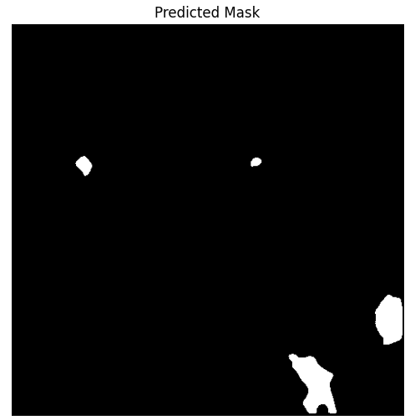
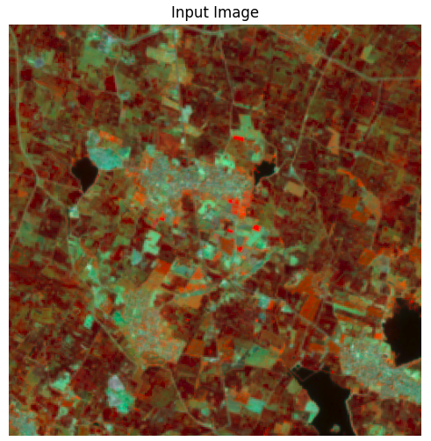
Prediction on Test Data

Slide 25
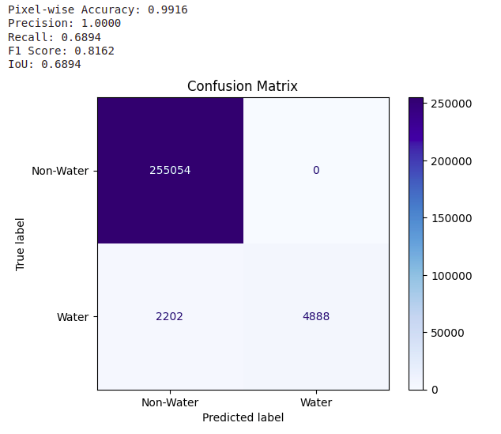

Slide 26
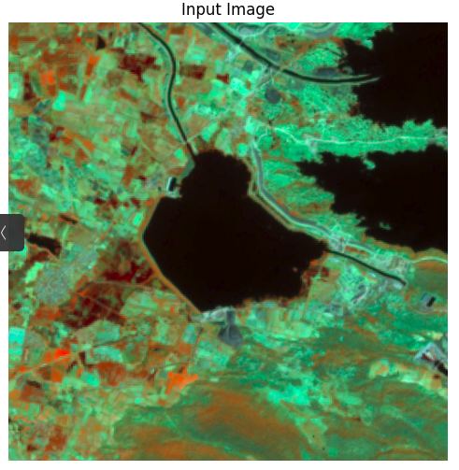
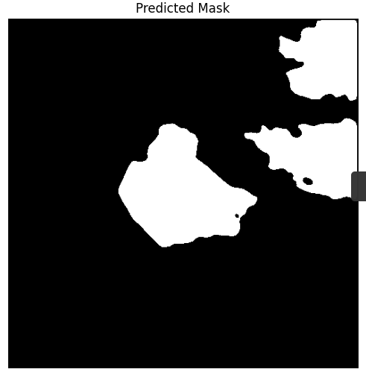

Slide 27
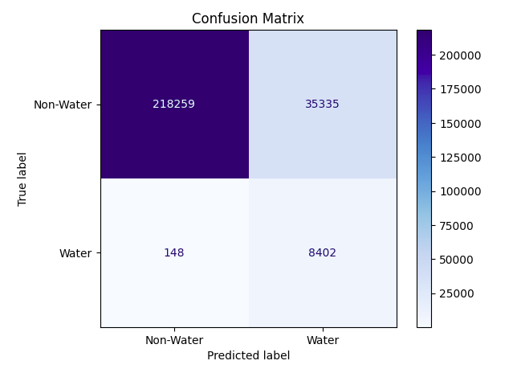

Slide 28
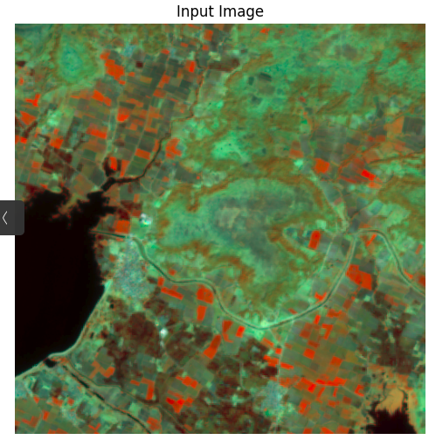
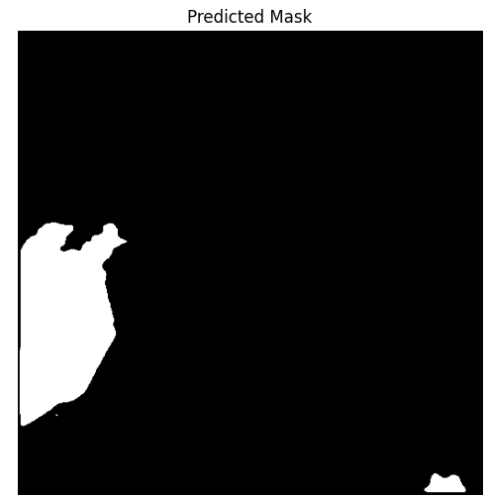

Slide 29


Slide 30
THANK YOU

